Slide 1
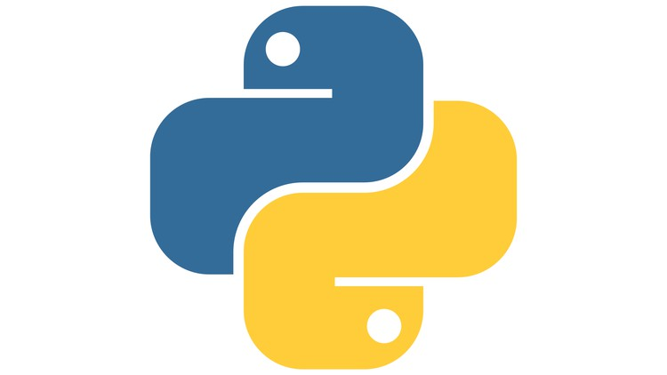
Understanding Key Python Concepts
Presented by
Saba Fatima (ITC)
Notes:
1

Slide 2
Topics
Decorators
Generators
*args, kwargs (Arguments , Keyword Arguments)
Basic Information (PEP 8:, Code Organization, Documentation, Version Control & Performance Optimization)
Notes:
How presentation will benefit audience: Adult learners are more interested in a subject if they know how or why it is important to them.
Presenter’s level of expertise in the subject: Briefly state your credentials in this area, or explain why participants should listen to you.
2

Slide 3
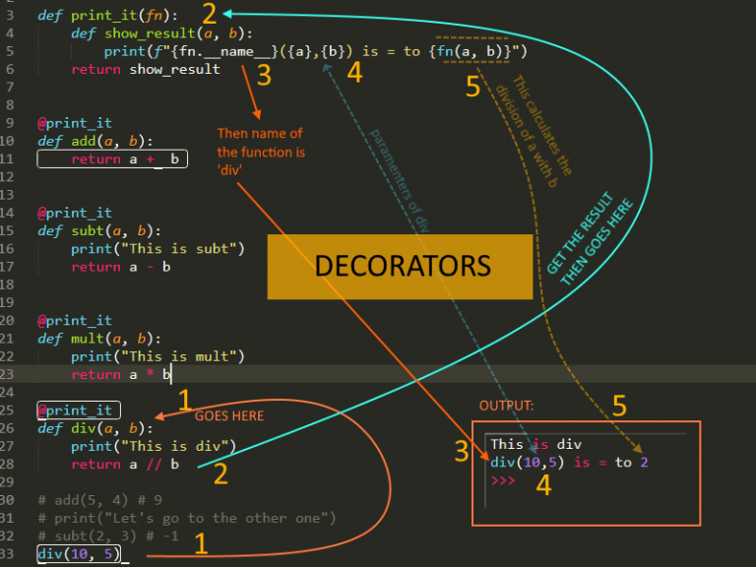
Decorator Basics
What are Decorators?
Decorators are functions that modify the behavior of other functions.
They are used to wrap a function and add functionality without modifying its structure.
Syntax: @Decorator_Name
Notes:
Example objectives
At the end of this lesson, you will be able to:
Save files to the team Web server.
Move files to different locations on the team Web server.
Share files on the team Web server.
3

Slide 4
Why Use Decorators?
Code Reusability
Code Readability
Separation of Concerns
DRY Principle
Notes:
4

Slide 5
Create Custom Decorators:
A decorator is a function that takes another function as an argument.
It returns a new function that can add functionality to the original function.
Example:
def my_decorator(func):
def wrapper():
print("Function is being decorated")
func()
return wrapper
@my_decorator
def greet():
print("Hello!")
greet() # Output: Function is being decorated \n Hello!
Notes:
5

Slide 6
Common Use Cases for Decorators
Logging: Track function calls.
Timing: Measure the execution time.
Authorization: Check user permissions before running a function.
Caching: Cache function results to improve performance.
Notes:
6

Slide 7
Chaining Decorators
Multiple decorators can be applied to a function by stacking them.
Order of decorators matters.
Example:
@decorator1
@decorator2
def my_function():
pass
Notes:
7

Slide 8
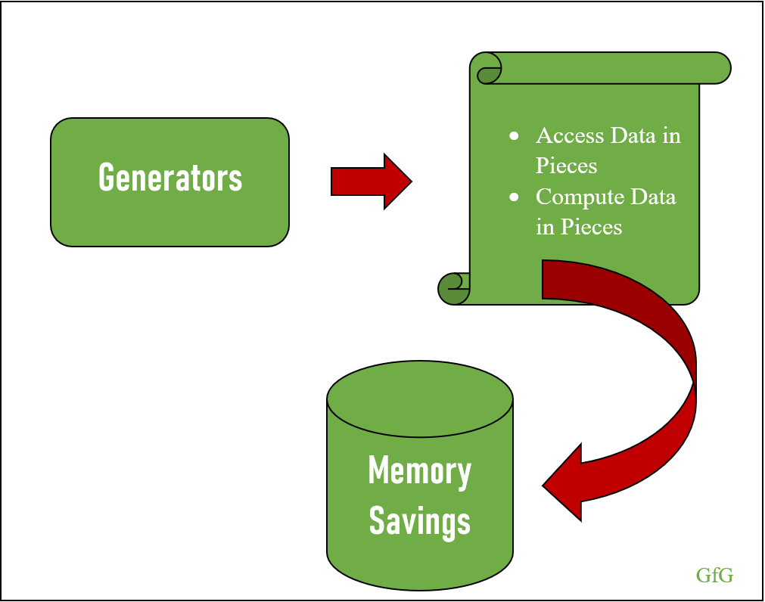
Generator Basics
What are Generators?
Generators are functions that produce a sequence of results lazily (one at a time).
They use the yield keyword to return values one by one.
Unlike regular functions that return a value and terminate, generators can yield multiple values on demand.
Notes:
8

Slide 9
Why Use Generator?
Memory Efficiency
Lazy Evaluation
Readable Code
Pipeline Processing ….
Notes:
9

Slide 10
Creating Generators
A generator is defined just like a regular function but uses yield instead of return.
The generator function doesn’t execute immediately but returns a generator object.
Example:
def count_up_to(max):
count = 1
while count <= max:
yield count
count += 1
counter = count_up_to(5)
print(next(counter)) # Output: 1
Notes:
10

Slide 11
Iterating with Generators
Generators are memory-efficient and suitable for large datasets.
You can iterate through a generator using a for loop or next()
Example:
def even_numbers(limit):
num = 2
while num <= limit:
yield num
num += 2
for num in even_numbers(10):
print(num) # Output: 2, 4, 6, 8, 10
Notes:
11

Slide 12
Generator Expressions
Generator expressions are like list comprehensions but produce values lazily.
Syntax: (expression for item in iterable)
Example:
gen_expr = (x*x for x in range(5))
print(next(gen_expr)) # Output: 0

Slide 13
Use Cases for Generators
Large datasets: Efficiently process large files or streams.
Pipeline processing: Chain multiple generators to create a processing pipeline.
Lazy evaluation: Only generate values when needed, saving memory.

Slide 14
Combining *args and **kwargs
*args allows passing a variable number of non-keyword arguments to a function.
The arguments are passed as a tuple.
Example:
def add_numbers(*args):
return sum(args)
print(add_numbers(1, 2, 3)) # Output: 6

Slide 15
**kwargs
It allows a function to accept an random number of keyword arguments. These arguments are packed into a dictionary.
def my_function(**kwargs):
print(kwargs)
my_function(name="Alice", age=25) # Output: {'name': 'Alice', 'age': 25}
It is used to unpack a dictionary into keyword arguments when calling a function. This allows you to pass a dictionary as a set of named arguments.
def greet(name, age):
print(f"Hello, {name}! You are {age} years old.")
user_info = {'name': 'Alice', 'age': 25}
greet(**user_info) # Output: Hello, Alice! You are 25 years old.

Slide 16
PEP 8: Writing Clean and Readable Code
PEP 8 is the Python Enhancement Proposal that defines the style guide for Python code.
Key recommendations: use 4 spaces for indentation, limit lines to 79 characters, and use descriptive variable names.

Slide 17
Code Organization
Break large scripts into smaller modules and packages.
Organize code logically to improve readability and reusability.
Use clear naming conventions for files, classes, and functions.

Slide 18
Documentation
Use docstrings to document functions and classes.
Use tools like Sphinx to auto-generate documentation.
def add(a, b):
"""Add two numbers and return the result."""
return a + b

Slide 19
Testing and Debugging
Version Control
Performance Optimization

Slide 20
Thank You….

